Slide 1
Building Confidence in Practice
Resource
Professional Curiosity
This resource pack aims to address Professional Curiosity so that practitioners can fully understand what it is and how to develop their skills when they are working with people whether they are children or adults.
The expectation is that you will share this resource pack widely and use it:
In team meetings
As part of a group/individual supervision
For your own development
You can look at it as a whole or dip in and out of it at your convenience. Use the icons to navigate through.
The Safeguarding Adults Boards and Safeguarding Children Partnerships of Leicester and Leicestershire and Rutland conduct reviews and multi-agency audits.
The objective of this resource pack is to share the learning on a specific topic to help build confidence in practice.
This resource is developed from work undertaken by Waltham Forest Strategic Partnerships, Manchester Safeguarding Partnership

Slide 2
Professional Curiosity (Click on each section)
What is it?
Why is it important?
Exercise in reflection….
Top Tips
Understanding what it looks like in practice
How to Refer, Procedures & Resources

Slide 3
Professional Curiosity
What is it?
Professional curiosity is a combination of looking, listening, asking direct questions, checking out and reflecting on information received. It means:
Testing out your professional hypothesis and not making assumptions
Triangulating information from different sources to gain a better understanding of individuals and family functioning
Getting an understanding of individuals’ and families’ past history which in turn, may help you think about what may happen in the future
Obtaining multiple sources of information and not accepting a single set of details you are given at face value
Having an awareness of your own personal bias and how that affects how you see those you are working with
Being respectfully nosey
Why is Professional Curiosity Important?

Slide 4
In order to Safeguard we need to be Professionally Curious….
Why is it important?
Thinking the Unthinkable: Safeguarding is everyone’s responsibility and where practitioners are concerned each and every agency has a role to play in safeguarding children and adults.
Nurturing professional curiosity and challenge are fundamental aspects of working together to keep children, young people and adults safe.

Slide 5
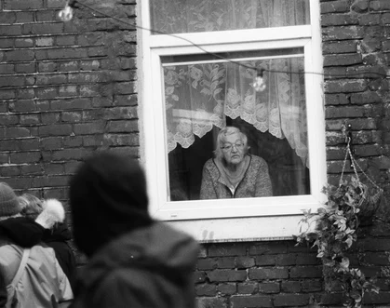
Absence of Professional Curiosity can lead to: - Missed opportunities to identify less obvious indicators of vulnerability or significant harm - Assumptions made in assessments of needs and risk which are incorrect and lead to the wrong intervention for individuals and families

Slide 6
EXERCISE: Reflecting on your own practice….
What might be some of the barriers to being professionally curious?
How might these barriers be overcome?

Slide 7
Understanding what Professional Curiosity is…..
Barriers
Supervision
& Leadership
Click boxes above to move to each section

Slide 8
Barriers
Fear of conflict and avoiding difficult conversations
Time pressures
Do I feel confident to deal with the response?
Do I know how to respond?
Not being able to help and/or not knowing what services are available
No knowledge of safeguarding and services
Thinking that it isn’t my role – someone else will deal with it.
Working in the community where I live

Slide 9
How do we overcome barriers?
Acknowledge that you are afraid
Recognise that you lack confidence
Ask for help – this could be by talking to your supervisor/manager or in supervision
Seek opportunities to develop your practice and understanding
Preparation - understanding the purpose of the contact and any previous worries or concerns. What are your roles and responsibilities - what is the legal ground/basis of the contact?
You don’t always know the answer to all questions – but be confident in saying that you will find out
This Photo by Unknown Author is licensed under CC BY-SA
Notes:
What about when we go out for a different purpose ie HV appt/Home care and something crops up

Slide 10
Supervision and Leadership

Slide 11
Supervision and Leadership
This is an important space for reflection
The use of effective supervision is a means of improving decision-making, accountability, and supporting professional development among practitioners. Supervision is also an opportunity to question and explore an understanding of a person or a family’s situation.
To work with people with compassion, but retain an open and questioning mind set, requires regular support through supervision.
Group supervision can be even more effective in promoting curiosity, as practitioners can use these spaces to think about their own judgments and observations. It also allows teams to learn from one another’s experiences.

Slide 12
Tips for supervision/practice
Offering an alternative perspective/hypothesis
Looking at a situation from the child, young person, adult or another family member’s perspective
Recognising time pressure as a barrier – look at workload/planning
Recognise when risks and concerns are escalating and taking appropriate action

Slide 13
Tips for supervision/practice
Knowing your worker’s personality traits:
Do they like to be liked?
Are they a rescuer?
Are they skilled in formulating and asking questions?
Knowing your worker’s skills and knowledge:
Are they confident to spot the signs and indicators of harm?
Rule of optimism (wanting progress and therefore missing/down playing signs that might be concerning)
Are they working in a community where they live – address any conflict of interest?

Slide 14
Remember to consider…
Rule of optimism
Wanting things to be better – not ‘seeing’ that things are not changing or worsening
Putting greater emphasis on small changes to provide evidence of positive change
Is the behaviour normalised – they have always done it?
Disguised Compliance
Involves a parent/adult/carer giving the appearance of co-operating with agencies to avoid raising suspicions, to allay welfare agency concerns and ultimately diffuse professional intervention (Building Confidence in Practice – Resistant Behaviour)
Unconscious Bias
Having a prejudice against a person/group of people or their circumstances/environment that you are not aware you have
Notes:
Perhaps start with ‘why does this feel wrong’

Slide 15
Top Tips (click on words to move forward)
LOOK
LISTEN
ASK
CHECK OUT
Always trying to answer the question(s):
‘How does it FEEL?’ or ‘Why does this FEEL wrong?’
Notes:
How does it FEEL? Gut instinct – ‘Why does this feel wrong?’

Slide 16
Top Tips
Is there anything about what you see when you meet with this child/adult/family which prompts questions or makes you feel uneasy?
Are you observing any behaviour which is indicative of abuse or neglect?
Does what you see support or contradict what you are being told?
Remember – behaviour is also a way for people to communicate…..
This Photo by Unknown Author is licensed under CC BY-SA

Slide 17
Top Tips
Are you being told anything which needs further clarification?
Are you concerned about what you hear family members say to each other?
Is someone in this family trying to tell you something but is finding it difficult to express themselves? If so, how can you help them to do so?
Notes:
Add slide – re: communication?

Slide 18
Remember….
Always keep the individual at the centre of your work
What is it like to be them – what is their lived experience?
What are they saying to you about their life?
Does what they say match with what you are seeing?
Is someone else advocating – such as a parent/carer? Do you know whether that is what the child or adult really wants to say?
Some children or adults may not have been able to voice concerns before….
COMMUNICATION IS KEY

Slide 19
Top Tips
Top Tips
Are there direct questions you could ask when you meet this child/adult/family which will provide more information about the vulnerability of individual family members?
Are there direct questions you could ask when you meet this child/adult/family which will provide more information about the vulnerability of individual family members?
HERE ARE SOME EXAMPLES
How do you spend a typical day? | How did you get that injury? | Peter is very tired today, and says he has not slept is there anything that might be troubling him?
Who else lives in your house with you? | Who is this with you? | I have noticed Priti seems hungry in the mornings, is she having breakfast before she comes to the day centre/school?
What are the things that make you happy? | When do you feel safe? | What happens when your mum is very sad?
What do you look forward to? | Why are you not at school? | I noticed that there isn’t very much food here, and wondered why?

Slide 20
Remember…
This is about safeguarding
You only need to ask questions to triangulate information or gain clarity
If what you see or hear doesn’t make sense, or you feel concerned, then you may need to ask questions to find out more information
It may be appropriate in your role to share information with someone else, however you may also be able to ask a question

Slide 21
Top Tips
Are other professionals involved?
Have other professionals seen the same as you?
Are professionals being told the same or different things?
Are others concerned? If so, what action has been taken so far and is there anything else which should or could be done by you or anyone else?

Slide 22
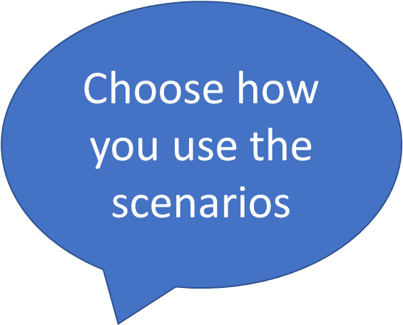
Discuss the Scenarios and answer the questions Click on the arrows for each Scenario
Understanding what it looks like in Practice
B
C
D
A
E
F
G
In each scenario think about:
What is worrying you?
Who would you talk to?
What questions might you ask?
Where might additional information come from?
Remember the ‘voice’ of child or adult

Slide 23
OLIVER 6 months old
A
Oliver has been attending your setting for 3 months. The mother always drops off and collects the child, however, this week an unknown male has been dropping off.
You’ve noticed that Oliver has been unsettled and that mum doesn’t chat so much at collection time.

Slide 24
Possible Scenario Answers
A
What is worrying you?
Who would you talk to?
What questions might you ask?
Where might additional information come from?

Slide 25
OLIVER is 6 months old
What questions might you ask?
“We’ve noticed Oliver has been quite unsettled can you think why that might be?”
“Are you ok – you seem a bit quiet?”
“We also wanted to check who the man was who drops her off as he isn’t on our list”
“Hello – I don’t think we’ve met before, my name is Jo and I am Oliver’s key person – can I ask who you are and your relationship to Oliver”
What is worrying you?
Oliver appears unsettled recently
The change in behaviour of mum
Unknown Male
Who would you talk to?
Mum
Unknown Male
Other staff in the setting
Any other professional involved with Oliver
Observe Oliver
Additional Information could come from: Mum, the unknown male, any other person who drops off or collects (grandparent(s)?), any professional involved i.e. Social Worker if child on a child protection plan and by observing Oliver’s physical wellbeing and behaviour

Slide 26
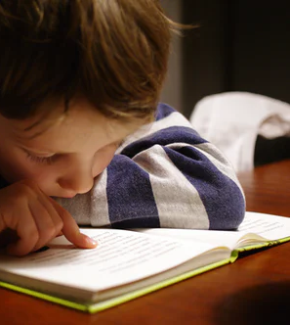
Jay is 10 years old
B
Jay’s mother died suddenly when Jay was 7 and he went to live with his dad at that point. He now lives with his father’s ex-partner Becki as they have recently separated.
He goes to the local school where he has been known to bully children in his class – pinching and pushing them as well as calling them names. This led to school speaking to Becki and dad.
In conversation: Jay says he’s scared of being alone – everyone has left him – nobody would miss him.
You are from Early Help working with Jay and Becki as she has said she is struggling and is worried about his mental health.

Slide 27
Possible Scenario Answers
B
What is worrying you?
Who would you talk to?
What questions might you ask?
Where might additional information come from?

Slide 28
Jay - 10 years old
B
Questions:
To Jay
“I get the feeling that you are sad – what is making you sad?”
“Are you worried? Are you scared? Where do you feel safe?”
“I’d really like to know about your day…”
To Becki
“Are you happy to be looking after Jay?”
“What support do you think you need to continue caring for Jay?”
“What are you worried about?”
To Dad
“Are you happy for Becki to be looking after Jay?”
“What support are you giving Jay and Becki?”
What is worrying you?
Bereavement & loss
Instability of placement - Is this private fostering?
Jay may harm himself
Jay’s behaviour/bullying
Who would you talk to?
Jay
Becki
Dad
Grandparents if involved
School
Any other professional/family involved with Jay
What is known about Becki?
Relationship with father
Additional Information
Physical appearance and health
Observation of Jay’s interactions with other children and adults in particular Becki and Dad
Condition of the home environment

Slide 29
Leanne aged 15
C
Leanne attends your school where you are the designated safeguarding lead (DSL). You’ve been told that although she is registering in the morning and afternoon, she doesn’t appear to be in school – you never see her around at other times.
Leanne is a really bright child and could go to university – however since coming back after half term her grades have significantly slipped.
The other day you saw her get into the car of Jake who is in his 20s, and used to attend the school. He was permanently excluded because of a violent incident. You ask her how she knows Jake and she says that he’s her boyfriend.

Slide 30
Possible Scenario Answers
C
What is worrying you?
Who would you talk to?
What questions might you ask?
Where might additional information come from?

Slide 31
Leanne aged 15
What is worrying you?
Grades slipping; association with older male; exploitation?
Who would you talk to?
Leanne
Other teachers
Parent(s)
Any other professional involved with Leanne
Additional information
School records – grades/attendance
Observation of behaviour/interactions with other pupils – especially friendship group and any changes in that group.
Other teachers
Possible questions to ask:
“Are you OK?”
“I’ve been reading information for parents evening and have noticed that your grades are lower than last term.”
“I’m a bit concerned that I’ve seen you with Jake because he is quite a lot older than you!”

Slide 32
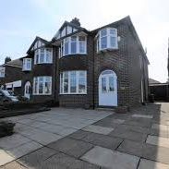
24,Oak Road
D
Three bedroomed privately rented semi detached town house.
Neighbours have complained because of the amount of rubbish – some of which has been spilling over and also some has been put in their bins. They are worried about vermin as some rats have been spotted.
There are a lot of vehicles that come and go – a lot of nice fancy cars and sometimes a transit van.
They also say that there seem to be a lot of people living there.
Environmental Health attend and find 2 men who didn’t want to let them in. When they showed their ID and were more insistent they were able to get inside the doorway where they could see several mattresses in the back room plus piles of sleeping bags and clothes. A woman, who appears to be in the later stages of pregnancy, was sitting on a mattress with a small child.
There didn’t appear to be a lot of other furniture.
Also, in the kitchen, there were a lot of unwashed pots and takeaway boxes lying around.

Slide 33
Possible Scenario Answers
D
What is worrying you?
Who would you talk to?
What questions might you ask?
Where might additional information come from?

Slide 34
24, Oak Road
D
What questions could you ask?
“It seems that there is a lot of rubbish – I just wondered how many people live here?”
“Who is your landlord? Who do you give ‘rent/money’ to?”
“Who would be the best person to speak to about getting the rubbish cleared?”
“Are you feeling ok, when is your baby due?”
“Ask general questions about the child – such as age, name, what do they like doing, and where do they sleep?”
“Do you all sleep in this room – are there more rooms/people upstairs? May I have a look?”
“Do you go out to work? What is it that you do?”
Additional Information
Observation of the physical wellbeing of people present including the child.
Do any of the people present appear to have support needs for example around a learning disability or mental health?
Observation of house/environment
The interactions between the people present and their willingness to interact with you
Landlord if possible/appropriate
What is worrying you?
There’s a child in this environment
That there are more people than there should be living there
There may be some exploitation of the people living there
Is the pregnant woman registered with her GP and receiving antenatal care?
Who would you talk to?
The people present
The neighbours
Your manager
The agency safeguarding lead
Police

Slide 35
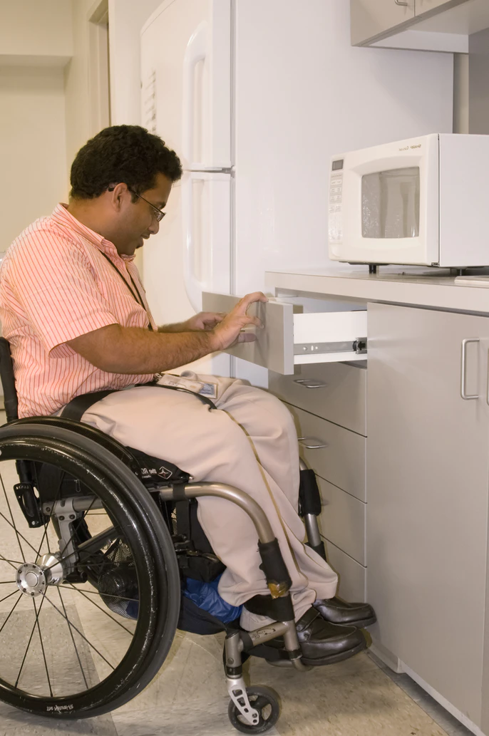
John aged 32
E
John has autism and uses a wheelchair due to muscular deterioration. He lives at home with his elderly parents and he attends the day services where you work 3 days a week. John appears to have lost weight, and is showing no interest in his favourite foods and activities. Whilst John does not communicate verbally his mood and behaviour usually indicates what he likes and dislikes.
John’s parents transport him to the service.
Notes:
Was not brought? Reference films for was not brought – resources

Slide 36
Possible Scenario Answers
E
What is worrying you?
Who would you talk to?
What questions might you ask?
Where might additional information come from?

Slide 37
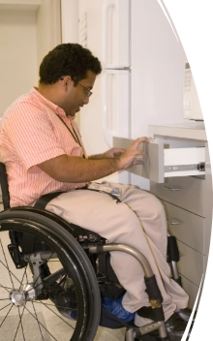
John aged 32
E
What questions might you ask?
“We’ve noticed that John isn’t eating, can you think of any reason why?”
“Has anything happened recently to upset him?”
“Has he been seen by a doctor?”
Where might additional information come from?
Observe John’s behaviour and responses – looking for patterns
Observe interaction between John and his parents
What is worrying you?
Weight loss
No interest in his favourite foods and activities
Is John’s weight being monitored?
Who would you talk to?
John’s parents
Your line manager
Any professional involved in John’s care such as GP, Social Worker, Speech and Language Therapist (SALT)
Report your concerns and any information from the parents to your line manager particularly if it’s felt that there is a contradiction i.e. that what the parents say does not match with what you are seeing.

Slide 38
Dora 71 & Keith 73
F
Dora and Keith have been together for 40 years. Dora has dementia and Keith, although he has severe arthritis, is her full time carer.
A neighbour rings Adult Social Care and the Police as she has heard shouting and crying. Keith shouting that he will kill himself if she disobeys him. A couple of weeks ago the same neighbour heard shouting again and called to ask Keith if he needed any help but he declined.
Dora and Keith appear to have no friends or family – they are very private.
Adult Social Care had a referral from the GP 6 months ago for a Carer’s assessment but Keith refused a visit saying he would call if he needed anything.
Keith has now agreed to a home visit from a social worker.

Slide 39
Possible Scenario Answers
F
What is worrying you?
Who would you talk to?
What questions might you ask?
Where might additional information come from?

Slide 40
Dora 71 & Keith 73
F
What questions could you ask?
“Given that you have your own health problems and you are looking after Dora what is life like on a daily basis?”
“You have been heard shouting at Dora can you tell me a little bit more about this?”
“Are you able to take any time for yourself?”
“What help would you accept?”
“Do you have a plan if you were to be taken ill?”
“When was the last time you (Dora & Keith) saw a GP?”
“Is Dora’s dementia getting worse in your opinion?”
To Dora if appropriate/possible
“How are you feeling? Are you happy or sad? Are you frightened? Do you feel worried?”
“What have you done today?”
“What things do you and Keith do together?”
“Do you feel safe?”
What are you worried about?
Health issues (dementia/arthritis)
Shouting
Escalating aggression
Isolation
Refusal of help/services
Carer stress
What happens if one of them takes ill?
Domestic Abuse/Coercive Control?
Who would you talk to?
Keith (on his own); Dora (on her own); Neighbour; GP; & Any professional involved with them such as dementia service
Additional information:
Observation of the couple together and separately; Physical condition of both of them – and the home

Slide 41
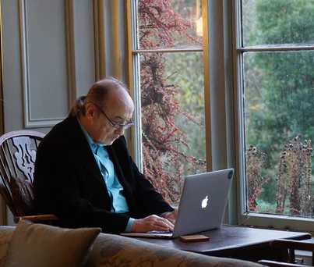
Tom aged 75
G
Tom lives alone and has severe osteo-arthritis and uses a walking frame. Tom only leaves the house to attend his local surgery where he goes for regular blood tests. He likes chatting to the staff in reception.
Tom has a son in Glasgow who he talks to regularly via Zoom.
Tom has come into the surgery without an appointment, and is telling you that he has no money for food this week as he has been helping a friend who is in financial difficulty. He says she’s a really nice woman.

Slide 42
Possible Scenario Answers
G
What is worrying you?
Who would you talk to?
What questions might you ask?
Where might additional information come from?

Slide 43
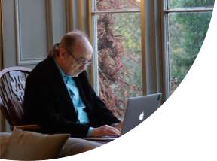
Tom aged 75
What is worrying you?
No money for food: turned up without an appointment which is a change in behaviour; the ‘woman’ he is helping; financial exploitation
In this situation in the first instance we need to get permission from Tom to speak to others.
If he says ‘no’ and you are still worried he or others are at risk of abuse, you can still share information with relevant agencies (see next slide).
You may want to talk to:
Adult Social Care, Son (if appropriate), Police if there is an immediate risk, GP/Practice Nurse, and anyone else that is involved that may be able to triangulate information.
What questions might you ask?
“Do you have anyone who can get you some food?”
“When will you have money again?”
“Who is your friend?”
“How do you know them?”
“Do they come to your house?”
“Is it someone you speak to online?”
“Does your son know your friend?”
“How often do you speak to her or see her?”
G
Additional information:
Observation of Tom’s physical appearance and mental health
Medical notes/history
Any other behaviour changes

Slide 44
How to Refer
How to Refer, Procedures & Resources
When you have concerns about an adult:
LEICESTER CITY: Concerned about a child or an adult? (leicester.gov.uk)
LEICESTERSHIRE or RUTLAND: Leicestershire and Rutland Safeguarding Partnerships Business Office - Concerned about an adult? (lrsb.org.uk)
When you have concerns about a child:
LEICESTER CITY: LSCPB | What to do if you are concerned about a child (lcitylscb.org)
LEICESTERSHIRE or RUTLAND: Leicestershire and Rutland Safeguarding Partnerships Business Office - Concerned about a child? (lrsb.org.uk)

Slide 45
Safeguarding Adults Guidance and Procedures
Multi Agency Policy and Procedures
Types of Abuse or Neglect
Criminal Exploitation of Adults
Modern Slavery
Domestic Abuse
Mental Capacity Act
Thresholds

Slide 46
Safeguarding Children Guidance and Procedures
How to Refer, Procedures & Resources
Safeguarding Children Partnerships Procedures Manual
Definitions of Child Abuse and Neglect
Private Fostering
Child Exploitation
Domestic Abuse/Violence
Thresholds for access to services

Slide 47
Resources
How to Refer, Procedures & Resources
Did Not Attend VS Was Not Brought
Children: Rethinking ‘Did Not Attend’ – YouTube
Adults: Was Not Brought: Assisted Doctor Appointment Challenges – YouTube
The Voice/Lived Experience of the Child
Was Not Heard – YouTube
Exploitation of Adults
Tricky Friends - Leicester, Leicestershire and Rutland – YouTube
Guidance for Working with Adults at Risk of Exploitation: Cuckooing – LLR SAB Multi-Agency Policies & Procedures Resource (llradultsafeguarding.co.uk)

